Slide 1
Predicting the Price of your next Beantown Domicile
MASS Boston Housing Data Analytics using R
Group 2 Yuwen-Himadri-George Project

Slide 2


1. Agenda
Team Approach
Explore Dataset
Linear Models
Random Forest Models
Logistic Regression Models
Conclusions
Next Steps
Geo

Slide 3

Team Approach
Geo

Slide 4
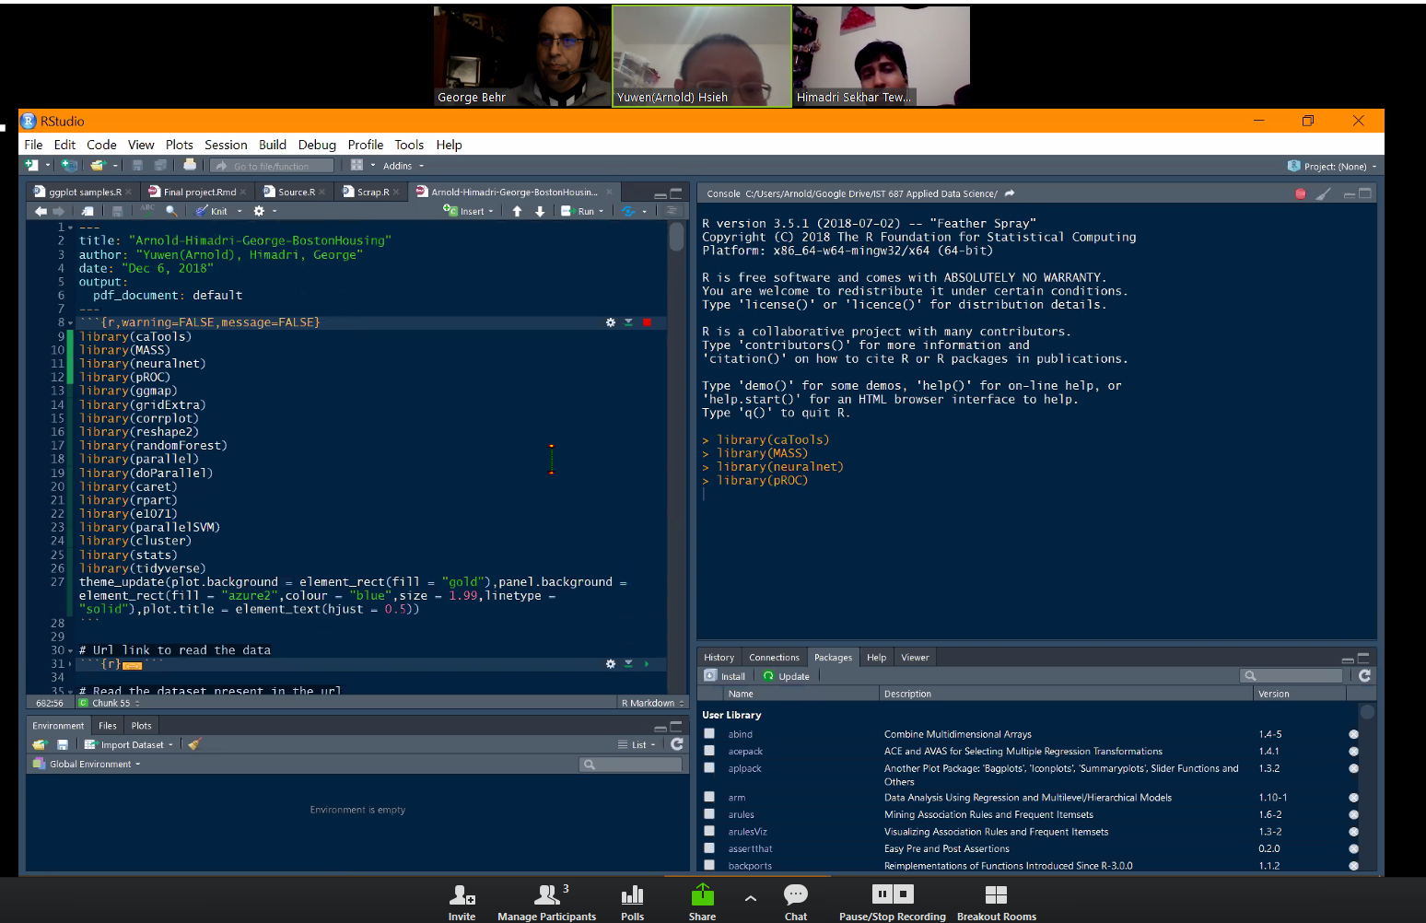

Weekly Saturday
Night Meeting!
(and Mondays, Fridays…)
Group Zoom sessions sharing some RStudio!
Slack channel
GitHub, Google Slides
Geo

Slide 5
Divide & Conquer
Our team attacked the project in this manner:
Regular (weekly) team Zoom meetings, and a dedicated private Slack channel
Gather findings individually, shared in Google Slides & RMDs on Slack
Curate the compiled assets collectively into a logical slide presentation & an RMD file for delivery
Geo

Slide 6
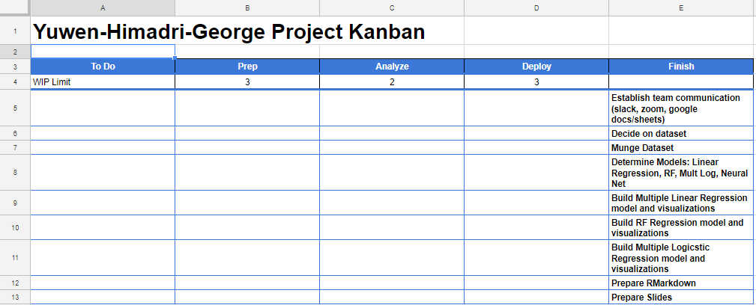
Deliverables
This Google Slide Presentation to Class
Also delivered as PDF to Professor
Code supporting our work in an RMarkdown RMD file
Also delivered to Professor
Project Kanban
Used early

Slide 7

What does the data look like?
(Exploratory Data Analysis)
Content & Structure
What data elements are contained in the Boston dataset?
Geo

Slide 8
“Boston Housing”
Abbr | Column Description
CRIM | per capita crime rate by town
ZN | proportion of residential land zoned for lots over 25,000 sq.ft.
INDUS | proportion of non-retail business acres per town
CHAS | Charles River dummy variable (= 1 if tract bounds river; 0 otherwise)
NOX | nitric oxides concentration (parts per 10 million)
RM | average number of rooms per dwelling
AGE | proportion of owner-occupied units built prior to 1940
DIS | weighted distances to five Boston employment centres
RAD | index of accessibility to radial highways
TAX | full-value property-tax rate per $10,000
PTRATIO | pupil-teacher ratio by town
B | 1000(Bk - 0.63)^2 where Bk is the proportion of blacks by town
LSTAT | % lower status of the population
MEDV | Median value of owner-occupied homes in $1000's
The Boston Housing dataset is a popular resource for data scientists, with 506 observations of 14 columns from the Boston census of 1970. We used the MASS R package to load the data.
Goal: Predict the median value (MEDV) of homes using 13 Census-related variables
Geo

Slide 9
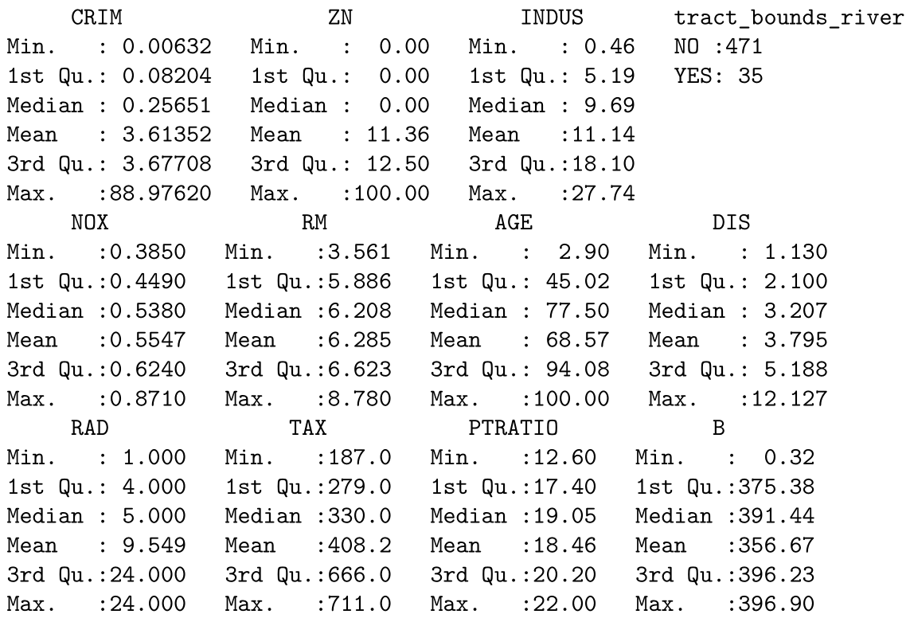
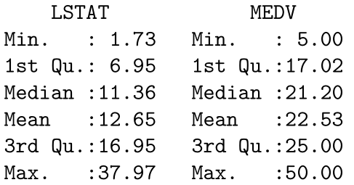
Exploratory Data Analysis EDA
Median Housing Value in Thousands of $ is what we are trying to predict
Max price in Boston is $50k? We wish.. This was an assumption of the original dataset
Himadri

Slide 10
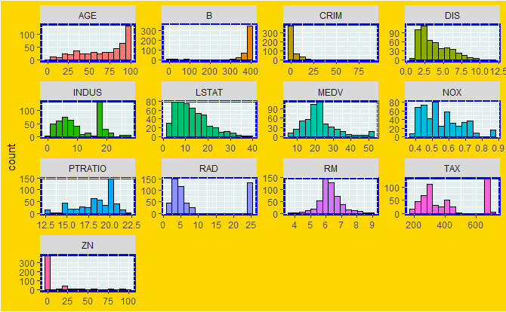
Histogram
Plot using GGPLOT + GEOM_HISTOGRAM
Himadri

Slide 11
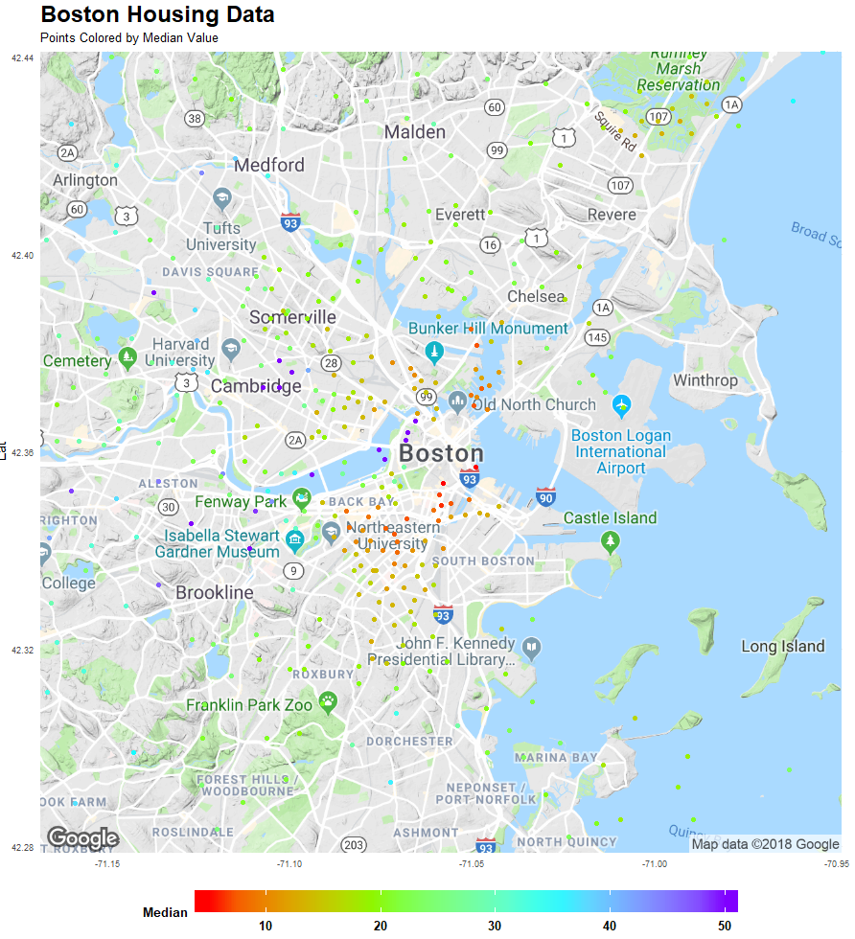
Data Mapped to Boston
Carnegie Mellon had an expanded MASS dataset that included towns, lat/lon geocoding and a corrected MEDV value
Highest median values in PURPLE and lowest values in RED (Why are some values in the water? You need to know the source of your geocoding! Sometimes you need to rotate!)
pBostonPlusHousing <- pBoston + geom_point(data=dfHousingC , aes(x=dfHousingC$Lon, y=dfHousingC$Lat, color=dfHousingC$Bldg.Value.Mdn.Corr)) pBostonPlusHousing <- pBostonPlusHousing + scale_color_gradientn( colors=rainbow(4), name="Median")
Geo

Slide 12
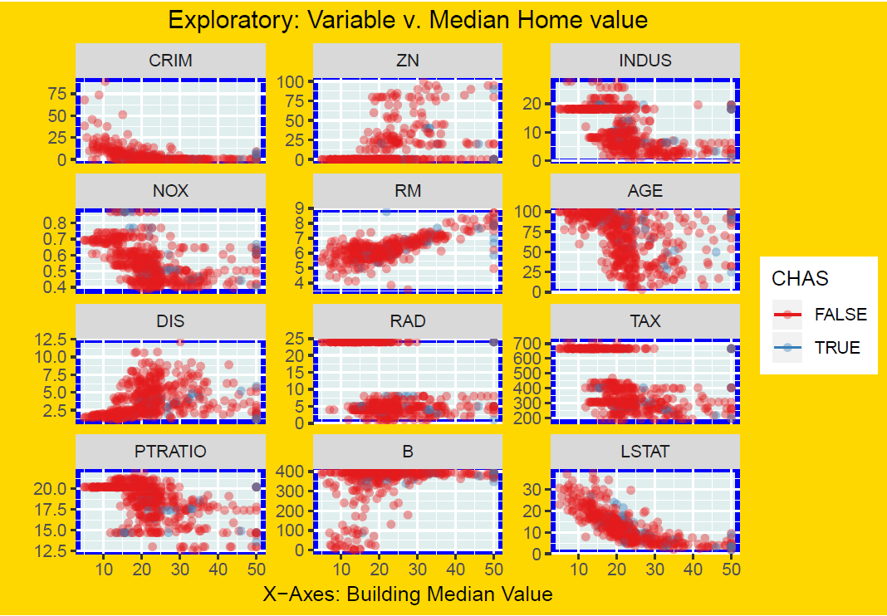
Plot of Continuous Variables
dfHousingTall <- melt(dfHousing[,-c(15)], id.vars=c("MEDV", "CHAS"))
# Now plot data using rug, facet, color brewer
pEDA <- ggplot(dfHousingTall, aes(x=MEDV, y=value, color=CHAS))
pEDA <- pEDA + geom_point(alpha=.4)
pEDA <- pEDA + geom_rug(data=dfHousingTall %>% filter(is.na(value)))
pEDA <- pEDA + labs(
title="Exploratory: Variable v. Median Home value"
, y="", x="X-Axes: Building Median Value")
pEDA <- pEDA + scale_color_brewer(palette="Set1")
pEDA <- pEDA + facet_wrap(~variable, scales="free_y", ncol=3)
Of the 12 charts, trends jump out on both LSTAT (Lower Status Pct) & RM (Rooms)
Geo

Slide 13
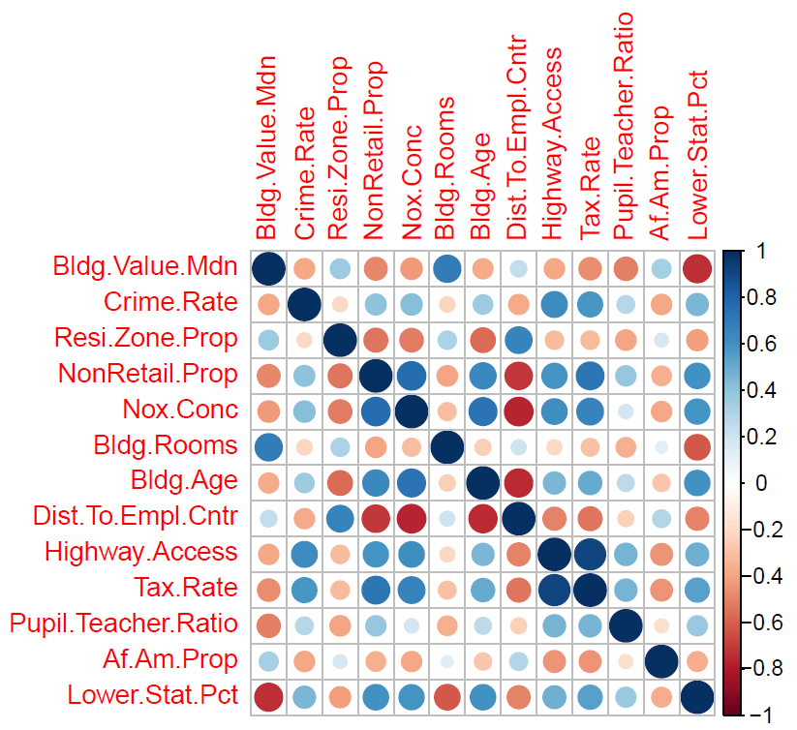
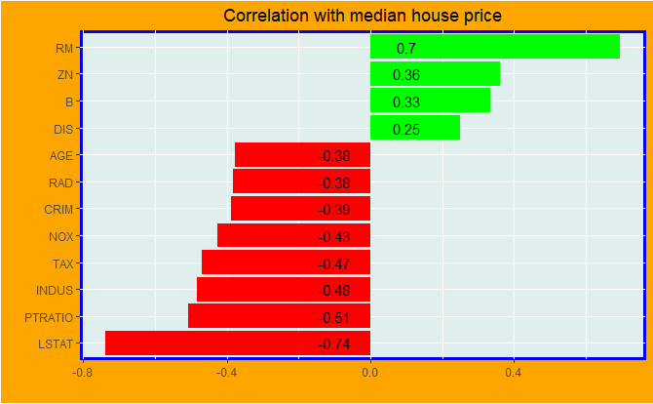
And again...
It is likely that LSTAT is impacting MEDV the most
LSTAT v. Lower.Stat.Pct: The MASS dataset and a lot of surrounding research demonstrate classic 1990’s techniques using cryptic attribute names (LSTAT, RM), often used to save ‘bytes’ in computer systems. Today, ‘self-documenting’ trends suggest using attribute and variable names that don’t make the next guy guess what that VAR means! Consider ‘Lower.Stat.Pct’ v. ‘LSTAT’; ‘Bldg.Rooms’ v. ‘RM’; ‘Dist.To.Empl.Cntr’ v. ‘DIS’
Geo

Slide 14
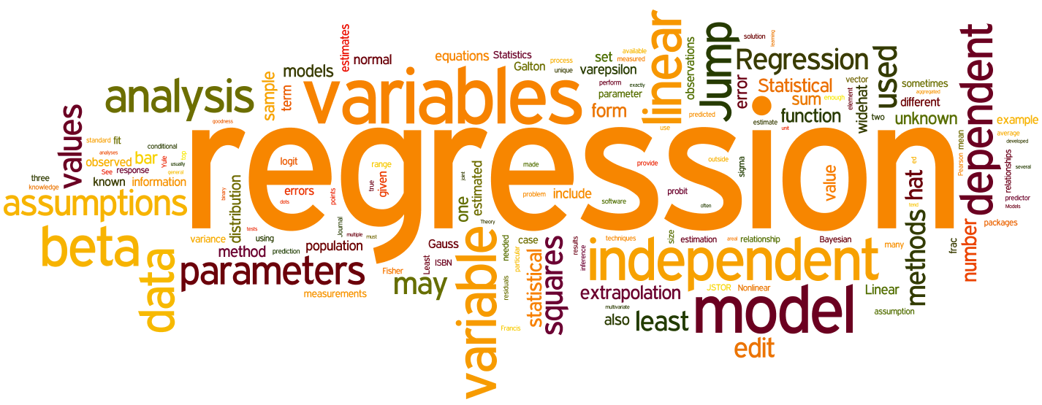
Linear Models
Himadri

Slide 15
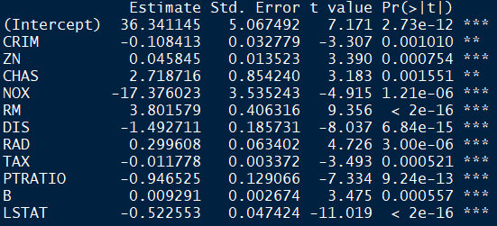
Multiple Linear Regression Coefficients
Removed INDUS and AGE
LSTAT & DIS had greater negative impact on the MEDV
Linear regression formula:
Y = 36.34 + (-0.11 * CRIM) + (0.05 * ZN) + (2.72 * CHAS) + (-17.38 * NOX) + (3.8 * RM) + (-1.49 * DIS) + (0.3 * RAD) + (-0.01 * TAX) + (-0.95 * PTRATIO) + (0.01 * B) + (-0.52 * LSTAT) + ε
Himadri

Slide 16
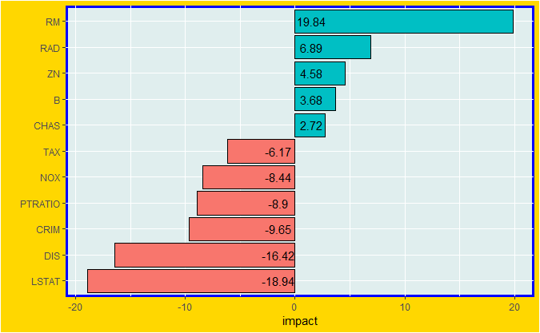
Multiple Linear Regression Visualization
RM dominates positive
LSTAT dominates negative
Himadri

Slide 17

Random Forest Models
Geo

Slide 18
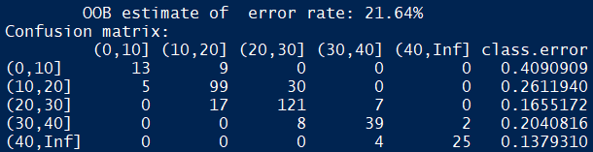
Random Forest Model
Confusion Matrix
# add stratification by $10k buckets (note no values above 50k)
dfHousing$MEDVS <- with(dfHousing, cut(dfHousing$MEDV, breaks = seq(0, 50, by = 10)
, labels = c('0-10', '10-20', '20-30', '30-40', '40-50')))
# Generate random forest, excluding MEDV values, and using stratified MEDVS
rf1 <- randomForest(dfHousing[,-c(14,15)], as.factor(dfHousing[,15]))
Grouped the MEDV value into $10k buckets
RF Confusion Matrix compares Actual values (columns) to Predicted values (rows), and details the error rate (21.64%) of your model
Columns: Actual Values from dataset (e.g. 18 actual values from $0k to $10k) | Rows: Predicted values from model (e.g. predicted 22 would be $0k to $10k, but 9 of the 22 were not, a 40% error rate)
Random Forest for Dummies: Don’t include your target attribute as a factor in your model!!
Geo
Geo

Slide 19
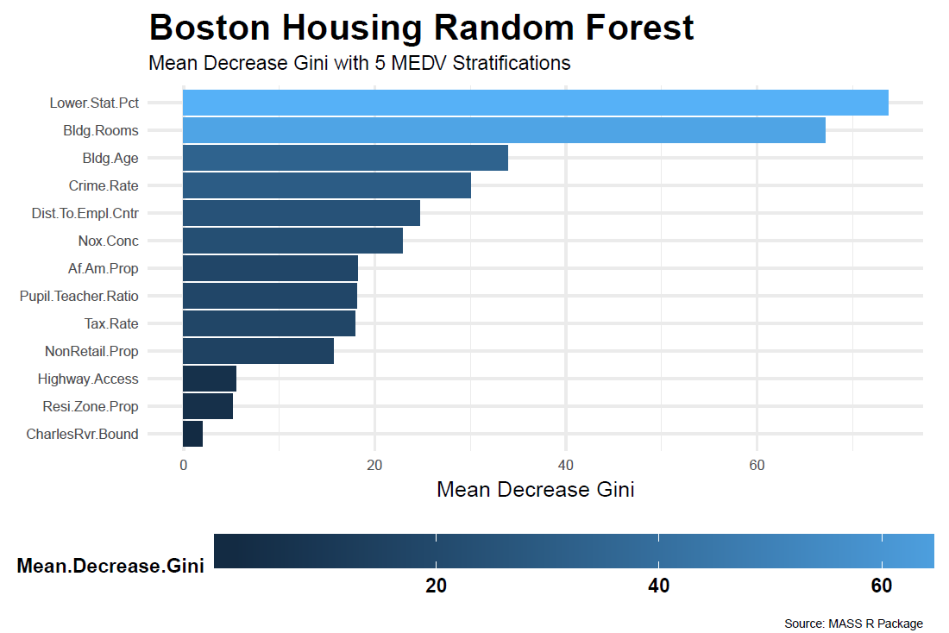
Random Forest Mean Decrease Gini
Lower Status Percentage (LSTAT) and Building Rooms (RM) proved to be dominant predictors in this Random Forest model.
“Corrado Gini”
Corrado Gini was one smart dude!
His works influenced the ‘Gini Impurity’: how often a randomly-chosen element from a set is incorrectly labeled if randomly-labeled according to distribution of labels in subset.
His works were written in Italian in 1912: we did not have time to translate
Geo

Slide 20
Multiple Logistic Regression Models
Geo

Slide 21
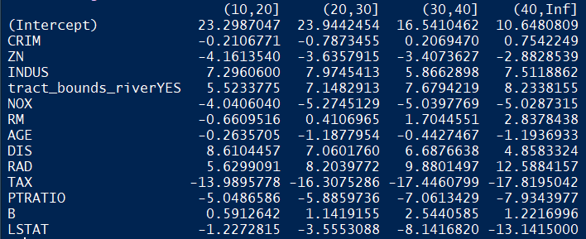
Multiple Logistic
Regression
Coefficients
Used 5 MEDV buckets (0-10, 10-20, 30-40, 40+)
Geo

Slide 22
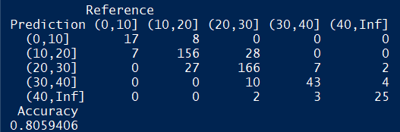
Multiple Logistic Regression Confusion Matrix
# Another way to stratify by $10k buckets (note no values above 50k)
rdf=df %>% mutate(cut5=cut(MEDV,c((0:4),Inf)*10))
# Generate model fitting
lgr=multinom(cut5~.-MEDV,data=rdf,subset = tr5,maxit=300)
Mult Logistic Confusion Matrix compares Actual values (columns) to Predicted values (rows), and details the Accuracy (80.59%) of your model
Columns: Actual Values from dataset (e.g. 24 actual values from $0k to $10k, 7 were predicted in 10-20 bucket) | Rows: Predicted values from model (e.g. predicted 25 would be $0k to $10k, and 8 were actually not)
Geo

Slide 23
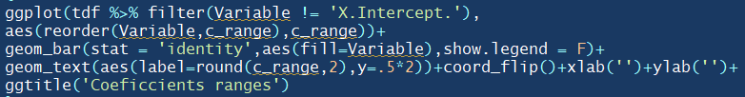
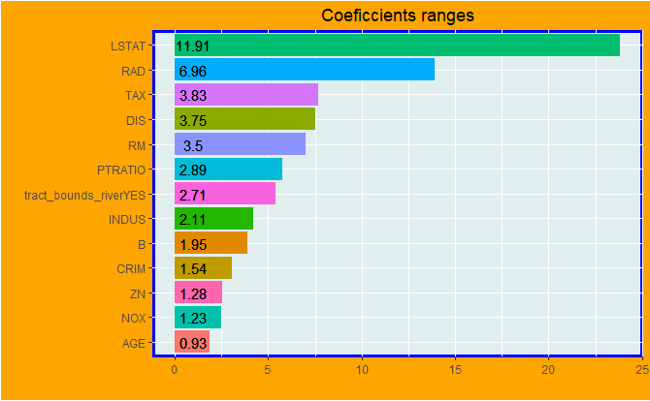
Multiple Logistic Regression Coefficient Viz
LSTAT dominates, RAD shows strongly
Geo

Slide 24


Neural Network
Himadri

Slide 25
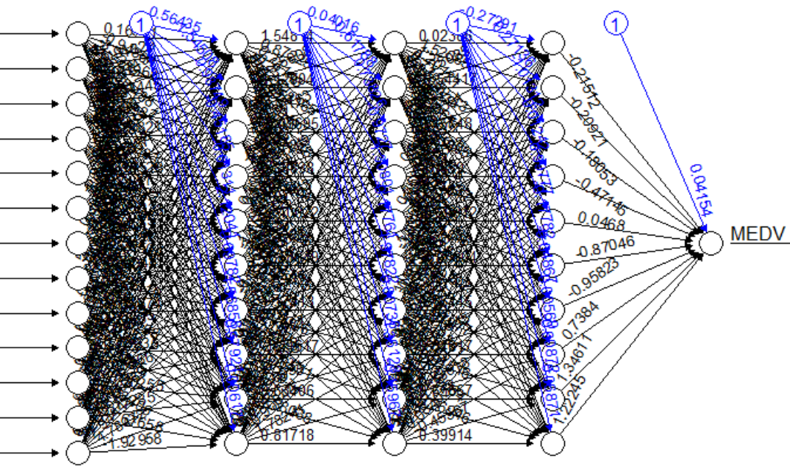
Neural Network
Himadri

Slide 26

Conclusions
Geo

Slide 27
Conclusion: Lower Status Percentage (LSTAT) Dominates
In all the models we ran LSTAT (lower status percentage) always ranked high in its predictive value.
Geo

Slide 28
Conclusions by Model:
Multiple Linear Model | Random Forest | Multiple Logistic
LSTAT and DIS dominate Removed INDUS, AGE | LSTAT and RM dominate Error rate: 21% | LSTAT and RAD dominate Accuracy: 81%
Geo

Slide 29
Next Steps
Address some data issues
“why did stratification volumes not align?”
Linear Regressions
Run assumption diagnostics & make appropriate changes
Use alternative regressions if necessary
Machine Learning
Decide which model is the best based on accuracy
Tune Hyper parameters
Run several ML models & use Majority Voting
Explore data by normalizing ‘no brainer’ attributes
“An 8-room house has higher MEDV than a 4-room house”
Additional Tasks
Hire Professor Santerre to improve our models!
Translate works of Corrado Gini!
Rerun models with boolean “Live next to rabid Patriots fan” set to FALSE
Geo

Slide 30

Bibliography
https://blog.datadive.net/prediction-intervals-for-random-forests/
https://arxiv.org/pdf/1501.07196.pdf
https://blog.datadive.net/interpreting-random-forests/
https://www.researchgate.net/publication/225818159_The_origins_of_the_Gini_index_extracts_from_VariabilitA_e_MutabilitA_1912_by_Corrado_Gini
http://tutorials.iq.harvard.edu/R/Rgraphics/Rgraphics.html
https://medium.com/@kmsbmadhan/crime-detection-with-boston-housing-data-set-using-linear-regression-in-r-part-1-b94fc2c4f8b2
Thanks!
The Boston Housing dataset has been thoroughly covered, even after the original scientists did their work. The links to the left reflect resources used in preparation of this project.

